Slide 1
COMP2003HK Computing Group Project
Group 5

Slide 2
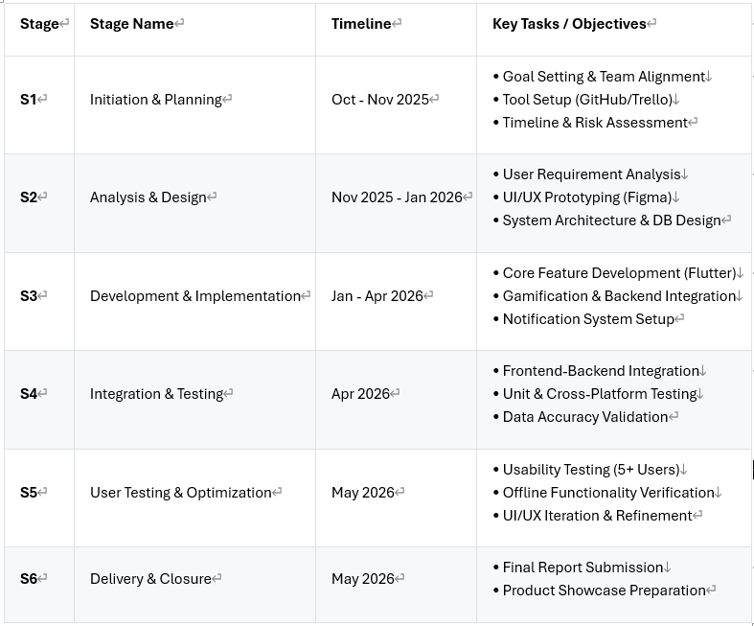
Project Planning Process

Slide 3
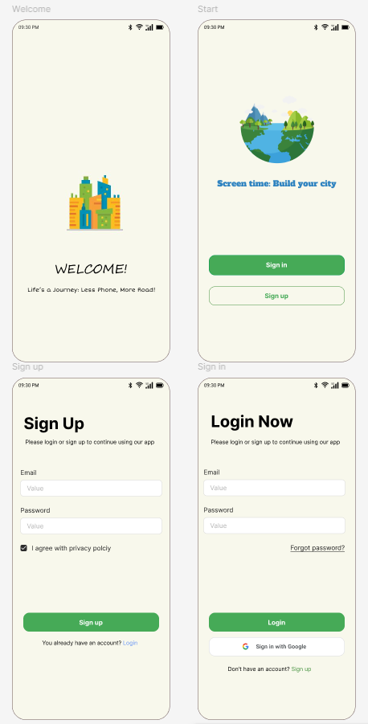
Welcome & User Login Page
Interface
Light colors (beige and green) for a calm and clear.
Easy Sign-up & Login
The familiar design makes it user-friendly.
Security
Using a trusted provider like Google makes users feel secure about their data.

Slide 4
Design Decisions
How We Chose Gamification Elements.
How We Prioritized Our Functionalities.
How We Chose Our Development Platform.

Slide 5
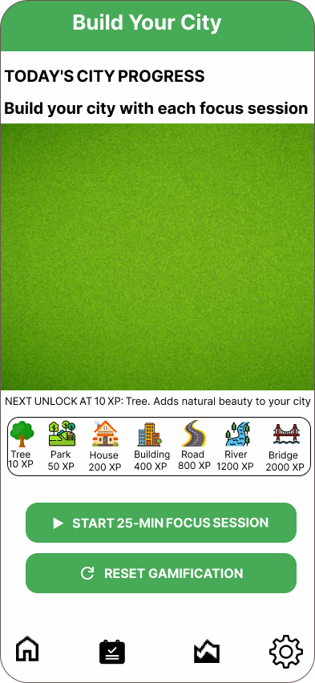
Gamification
Users earn XP by completing focus sessions
Spend XP to unlock building assets (trees, houses, roads)
Green spaces - drag & drop areas for personal utopia

Slide 6
Prioritized & Functionalities
MoSCoW method:
Must-have feature: Focus timers, city building, and activity logging form our core value
Should-have feature: Dashboards and notifications boost daily usage
Could-have features: like custom city themes remain optional for future iterations.
Won't-have features: such as leaderboards or social sharing were excluded to maintain privacy focus and scope control.

Slide 7
Technology Stack
Flutter: main development framework
Dart: programming language
SQLite: local database

Slide 8
Why This Combination Works
Single codebase for Android plus iOS
Smooth animations for city building
Secure offline data storage

Slide 9
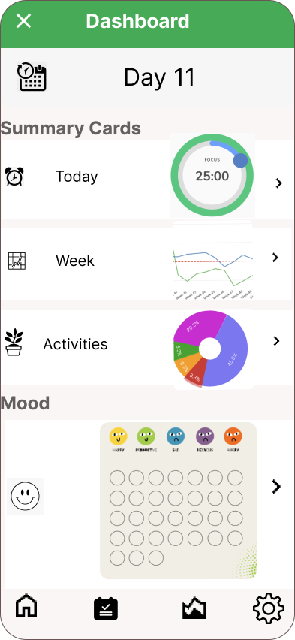
Dashboard
Dashboard Overview This dashboard provides users with a clear overview of their focus behaviour and wellbeing. It summarises daily focus time, weekly trends, logged activities, and mood records in a single screen. Visual elements such as charts and icons are used to help users quickly understand their progress and encourage continued engagement with the app.

Slide 10
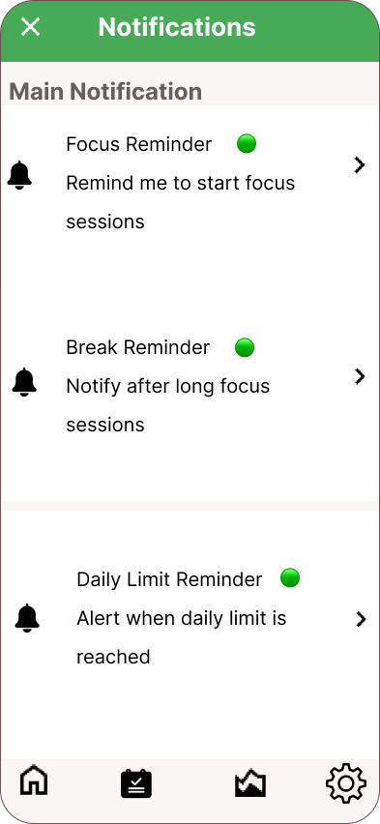
Notification
Notification Overview The notification feature supports users in building healthier focus habits. It provides timely reminders for focus sessions, breaks, and daily usage limits. Notifications are designed to gently guide users without being intrusive, helping them stay aware of their behaviour throughout the day.

Slide 11
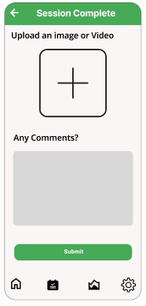
Session logging
Allows user to upload images or videos of evidence of offline activities
Allows user to add comments on the session or activity for their personal reflection

Slide 12
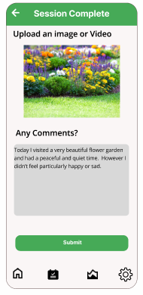
Session logging
example
Allow counselors, family/support group to see the details of each session and activity
User can review each session and reflect on the activity
User can also update the image or edit the comments if they wish

Slide 13
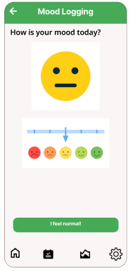
Mood logging
Emoji slider is used to maintain ease of use
User can either click on the corresponding emoji or drag on the slide to log their mood

Slide 14
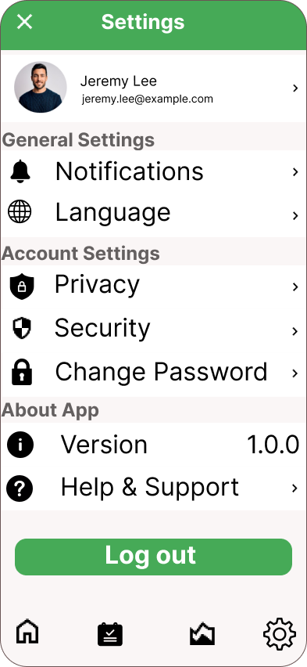
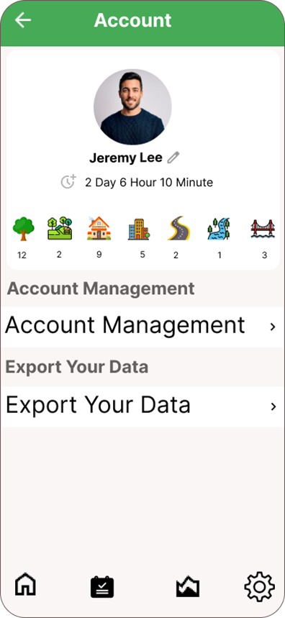
Setting & Account

Slide 15
Q&A
Thank You

